Slide 1
Multi-Agent Modeling of Risk-Aware and Privacy-Preserving Recommender Systems
Presented by: Vishnu Srivastava
David R. Cheriton School of Computer Science

Slide 2
Contents
Recommender Systems
Context Aware Recommender Systems
Problem Statement
Privacy in Recommender Systems
Risk in Recommender Systems
Risk Aware Recommender Systems
Multi-Agent Modeling Approach
Proposed Solution
Case Study: Job Recommender System
Conclusion
Limitations & Future Work

Slide 3
Recommender Systems
Recommender systems are software systems that produce a list of recommendations for its users by deploying in general two algorithms (i.e. collaborative filtering or content-based filtering) or a mix of these algorithms as a hybrid approach. The approach used in collaborative filtering utilizes the user’s historic data (i.e. items purchased by the user, browsing/navigation history on the website or the feedback provided for the purchased item).
Context Aware Recommender Systems
Current research in the area of RSs has focussed on context-aware RSs. A context-independent representation may lose predictive power because potentially useful information from multiple contexts is not taken into account. The ideal context-aware RS would, therefore, be able to reliably associate each user action with an appropriate context and effectively modify the system output for the user in that given context.

Slide 4
Proposed Approach: Structure
Description of the Relationship Model
Input
Input
Input
Breakdown of the System into Subsystems
Description of the goal model for the Subsystems
Design Behavior: Activity Model
Design Behavior: Sequence Diagram
Combined Model of the System

Slide 5
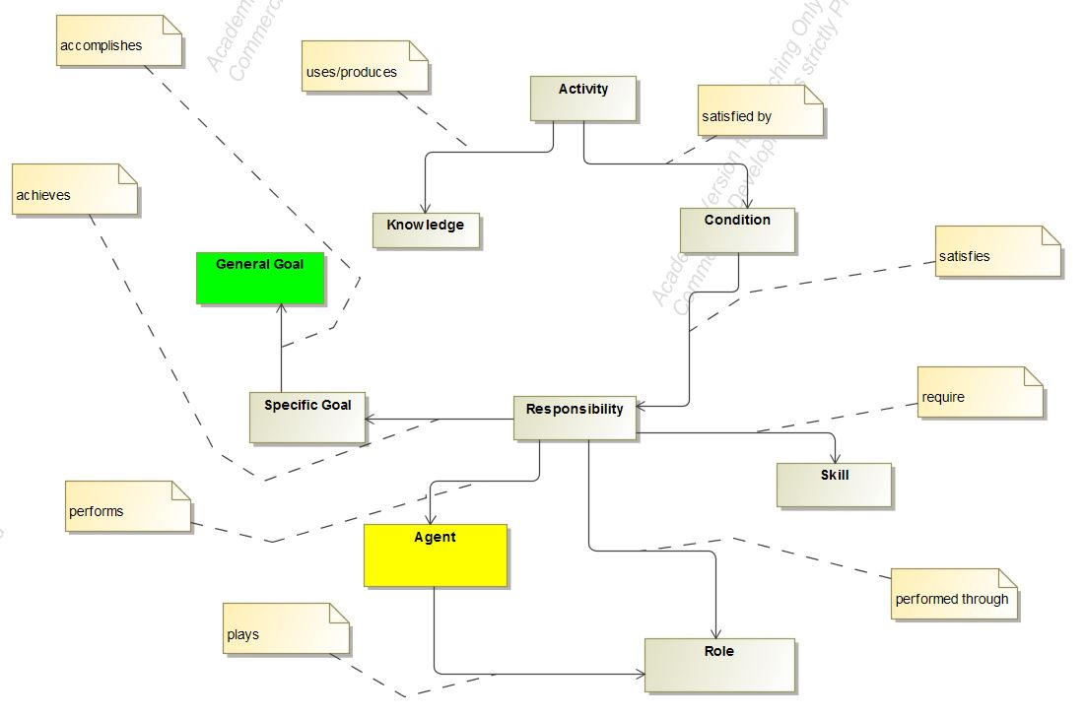
Proposed Approach: Relationship Model

Slide 6
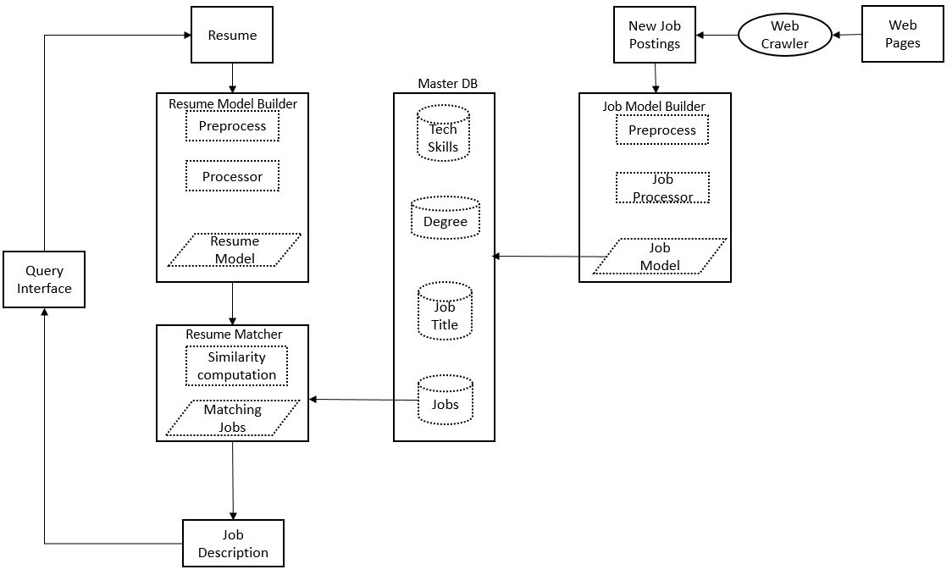
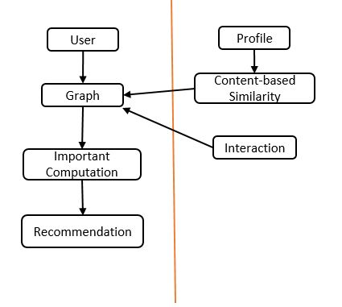
Job Recommender System

Slide 7
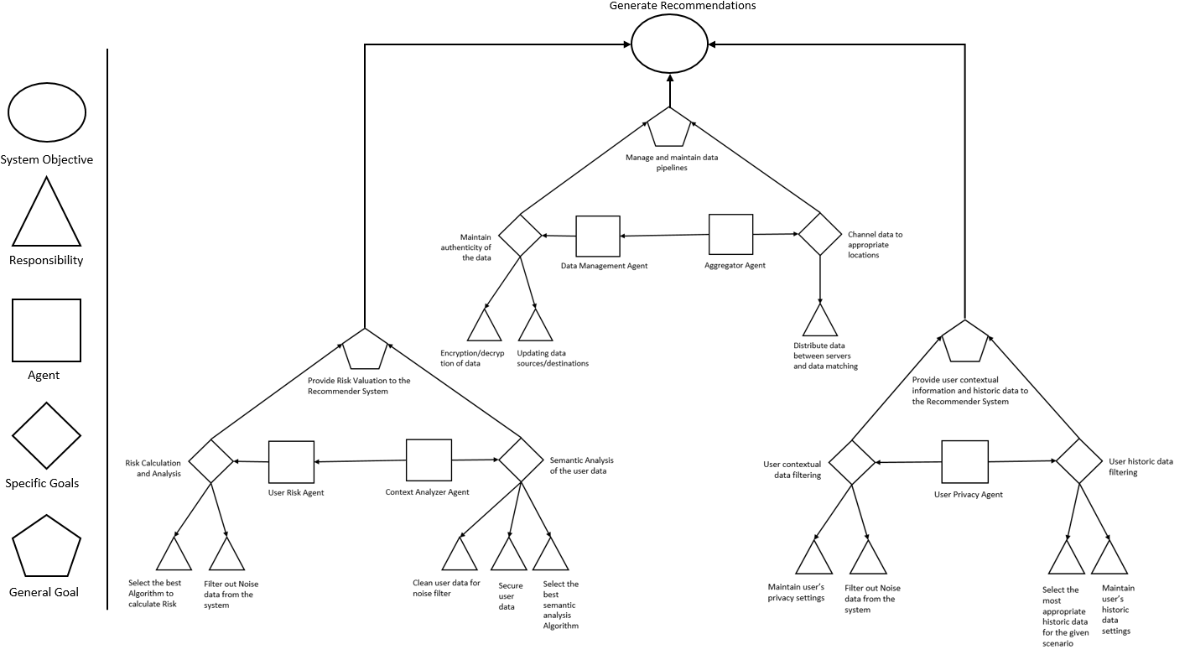
Combined Goal Model

